Slide 1
The Traffic Sign Recognition and Training (TSRT)
Group 2

Slide 2
Team Member
Supervisor: Kiều Trọng Khánh
Mai Văn Tân
Bùi Việt Phong
Hồ Đắc Nghĩa (drop out)
Trần Lê Tuấn (drop out)

Slide 3
Outline:
Scenario Problem
Current solution
Propose our solution
Technology and development environment
Demonstration
Advantages and Disadvantages
Future Plan

Slide 4
Scenario Problem
In Vietnam, we have more than 200 traffic signs
Many traffic signs is not familiar
⇨ Cause difficult to people when join in traffic

Slide 5

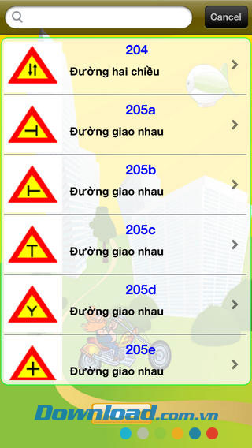

Current solution

Slide 6



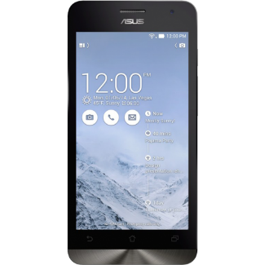
Propose our solution

Slide 7
Features
Recognition
Mobile Application
More and update information
Sync data
Learning

Slide 8
How to detect and recognition

Slide 9
Technology and development environment

Slide 10
Demonstration
Search auto in many conditions
Fix wrong recognize
Offline search
Sync favorite
Add new traffic sign

Slide 11
Advantages and Disadvantages
- Automatically
- Fast
- Support learn
- Need internet connection
- The accuracy not reach 100%

Slide 12
Future Plan
Improve recognition accuracy
Support more platform (iOS, Windows phone )
Support more traffic sign types
Public to end user

Slide 13
Q&A

Slide 14
Thank you

